Slide 1
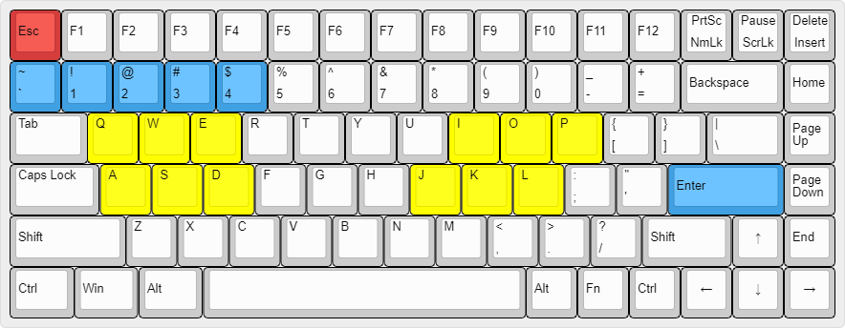
KEYBOARD SHORTCUTS
Keyboard | Function
1-4 | Set timer by the corresponding number of minutes
~/ ` | Set timer by increment of 30 seconds
Enter | Start/Stop timer
Q,W,E | Category 1 Foul in order (C,K,HC) | AO
A,S,D | Category 2 Foul in order (C,K,HC)
I,O,P | Category 1 Foul in order (C,K,HC) | AKA
J,K,L | Category 2 Foul in order (C,K,HC)
Esc | Reset the fouls and SENSHU checkbox. Only work before and after the timer is started. The timer is safeguarded against accidental reset during the countdown of the timer.
Notes:
Blue: #41A0E1
Yellow: #fffe00
Red: #d53d3c

Slide 2
